Slide 1
Auto-documentation: Still A Dream
Elizabeth Wickes
Data Cleaning final project

Slide 2
The problem
Research data is complex
Researchers aren’t paid to document
Those who do take the time to document do so in sacrifice for other tasks
Project question:
Can some of this be automated?

Slide 3
Project question
What of the documentation or profiling effort can be automated?
As in…
Which parts of documentation are simple programming problems?
Seems like much of the activity is
“Make that number, put it in. Write something” on repetition
Creating a template
So the documenting person can respond to prompts rather than creating something brand new

Slide 4
Current automation: Data profiling tools
Yes Workflow kind of does this, but for scripts
Annotate scripts to create workflow/provenance documentation
documentation effort granularity matches the research activity
make pretty chart: discover beauty or terror
Open Refine
Poke through graphs, look at counts
Fix things, learn, and clean
sapply(dataframe, summary)
Quick and dirty method in R to generate summary statistics over all columns in a dataframe

Slide 5
The approach
Let’s use Python
As many standard library modules as possible
“Why not use SQL?”
I wanted a command line tool that can traverse files and output a result file. I’m sure I could make this in SQL eventually.
“Why not use R?”
The summary() function would be valuable, but the data structure to hold it would be nasty.
Python as “proof of concept language” that could be ported to other systems

Slide 6
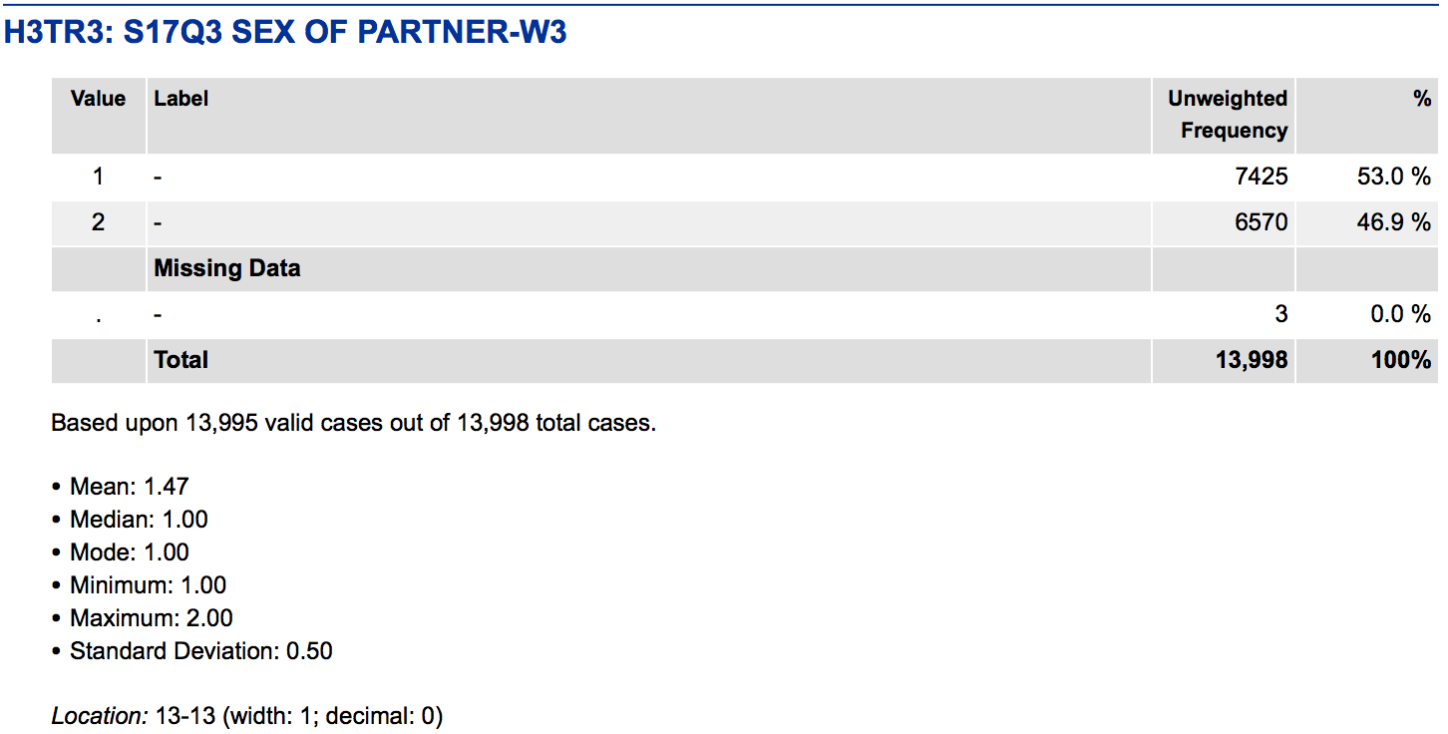
The beautiful world
Detect if data is categorical, ordinal, or continuous
Detect missing values
Create meaningful summary statistics
Basically, create ICPSR level codebooks via content aware algorithms
ICPSR codebook example

Slide 7
The Purpose
What can be automated?
Numbers (sorry humanists)
Basic descriptive statistics
Text content is harder, so skip it!
What can’t be automated?
Context
The valuable content to extract from a researcher is information on the context of questions
Goal: have the tool produce a basic readme template that the researcher can just fill information in.

Slide 8
Minimal proof of concept
Input?
CSV is the easiest and super common
Processing?
Count things, min, max, missing, percents, etc.
Focus on input
read in files, have slots for where to process things
have places for function additions
Focus on output
Going to produce very basic markup
Attempting to render that markup as HTML, but the basic options look odd

Slide 9
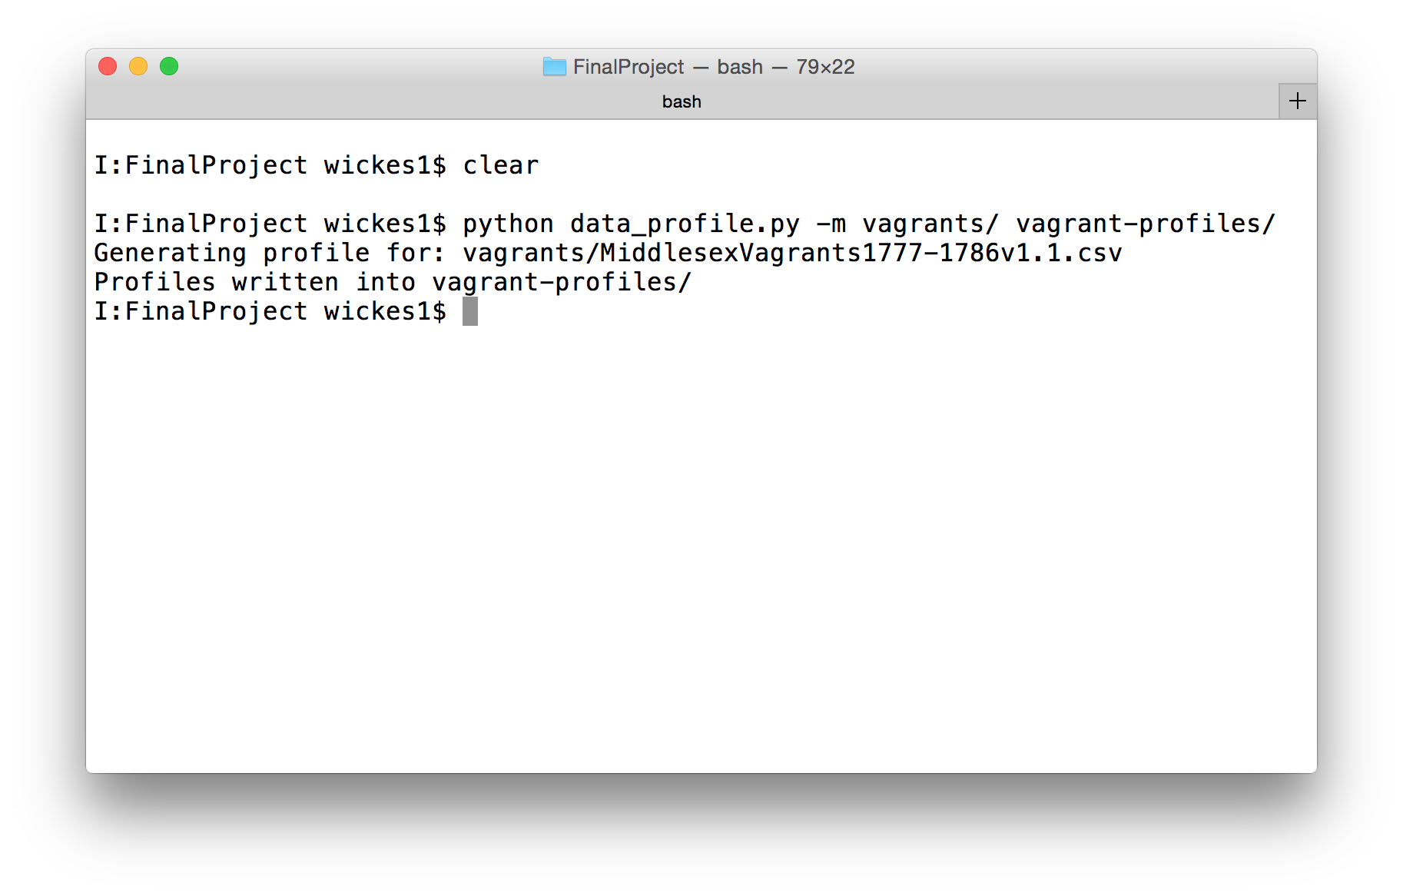
Basic use

Slide 10
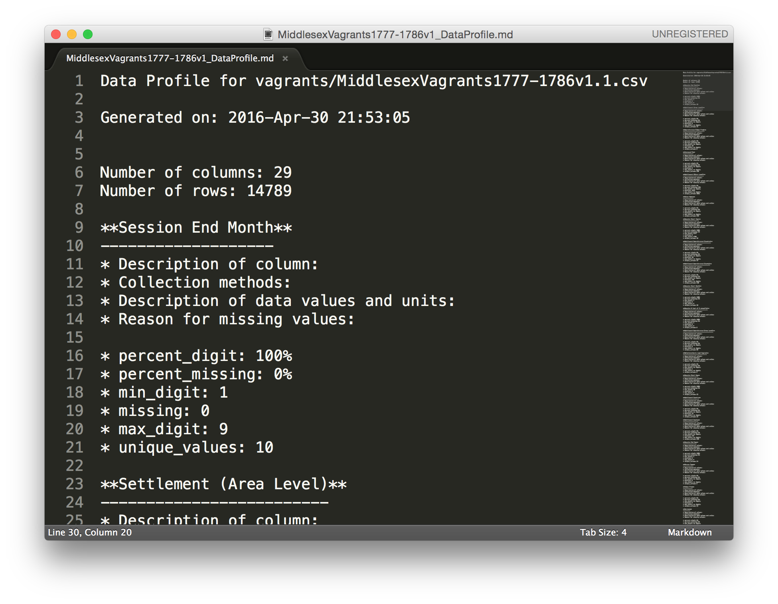
Basic use

Slide 11
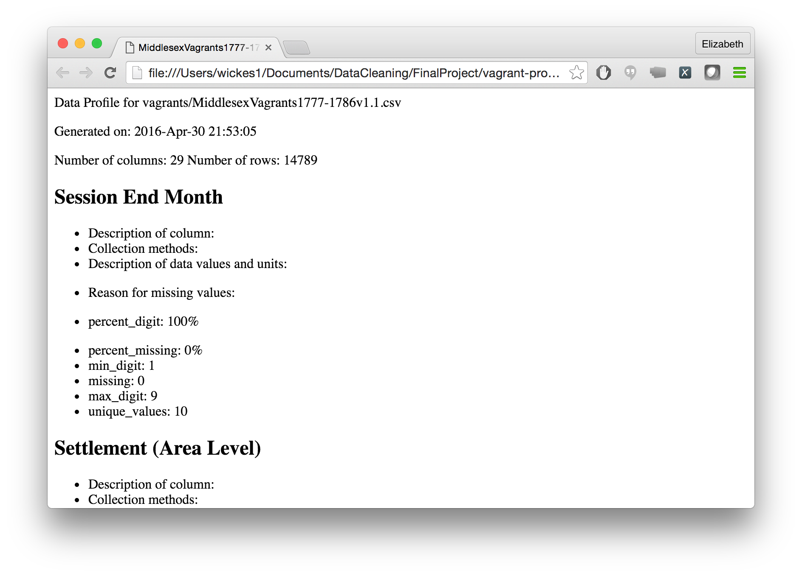
Basic use
UGH markdown

Slide 12
Future TODOs
Have a template file that uses the format() method to add values
Some sort of web interface to prompt users to fill out the descriptive narrative
Handle additional data types
Output a data file to run into SQL
Originally had a method of exporting the dataframe to a SQL DB file, but this required extra modules
If I dump out a CSV file people can read it into SQL
Basic data mining/correlation matrix to try and profile correlations and other dependencies between columns

